Slide 1
Detecting
Brain Cancer
Kaytlynn Skibo 04/17/22

Slide 2
WHy is this important?
Automating the process
Improve accuracy of diagnoses
Improving patient outcomes
Save on expenditures
Notes:
Automating the process: Machine Learning can help automate the process of identifying and diagnosing brain cancer, saving time and resources as opposed to manual review.
Improve accuracy of diagnoses: being trained on large datasets of medical images to learn patterns and features indicative of cancer.
Improving patient outcomes: early detection is crucial for successful treatment. A ML can learn assist in a quicker diagnosis and allow treatment to begin sooner.

Slide 3
Types of Cancer in This Dataset
Pituitary
Pituitary cancer is a rare type of cancer that originates in the pituitary gland, which is a small pea-sized gland located at the base of the brain.
Glioma
Glioma is a type of brain cancer that originates in the glial cells, which are the supportive cells that surround and nourish the nerve cells in the brain.
Meningioma
Meningioma is a type of brain tumor that originates in the meninges, which are the membranes that surround the brain and spinal cord.
Notes:
Pituitary cancer is a rare type of cancer that originates in the pituitary gland, which is a small pea-sized gland located at the base of the brain. The pituitary gland is responsible for producing and secreting hormones that regulate various bodily functions, including growth, reproduction, metabolism, and stress response.
Pituitary cancer is also known as pituitary adenoma, which is a noncancerous (benign) tumor that grows in the pituitary gland. However, in rare cases, pituitary adenomas can become cancerous (malignant) and spread to other parts of the body.
The symptoms of pituitary cancer depend on the size and location of the tumor. Small tumors may not cause any symptoms, while larger tumors can press on nearby structures in the brain and cause headaches, vision problems, hormonal imbalances, and other neurological symptoms.
Diagnosis of pituitary cancer typically involves a combination of imaging tests, such as MRI or CT scans, and blood tests to measure hormone levels. A biopsy may be needed to confirm the diagnosis.
Treatment for pituitary cancer depends on the type and stage of the cancer, as well as the individual's overall health. Surgery to remove the tumor is the primary treatment for pituitary cancer. Radiation therapy and chemotherapy may also be used to destroy cancer cells and prevent the tumor from recurring.
Prognosis for pituitary cancer depends on the stage and type of the cancer, as well as the individual's overall health. In general, early detection and treatment of pituitary cancer can lead to a better outcome.
Glioma is a type of brain cancer that originates in the glial cells, which are the supportive cells that surround and nourish the nerve cells in the brain. Gliomas are classified based on the type of glial cells they arise from and their grade, which indicates how quickly the cancer is likely to grow and spread.
There are several types of gliomas, including astrocytomas, oligodendrogliomas, and ependymomas. Astrocytomas are the most common type of glioma and can be further classified into grades I to IV, with grade IV being the most aggressive type, also known as glioblastoma.
The symptoms of glioma brain cancer depend on the location and size of the tumor. Common symptoms include headaches, seizures, changes in vision, difficulty speaking or understanding language, weakness or numbness on one side of the body, and changes in mood or behavior.
Diagnosis of glioma brain cancer typically involves a combination of imaging tests, such as MRI or CT scans, and a biopsy to confirm the type and grade of the tumor. A biopsy involves removing a small piece of tissue from the tumor and examining it under a microscope.
Treatment for glioma brain cancer depends on the type and grade of the tumor, as well as the individual's overall health. Surgery to remove as much of the tumor as possible is usually the first line of treatment. Radiation therapy and chemotherapy may also be used to destroy cancer cells and prevent the tumor from recurring.
Prognosis for glioma brain cancer depends on the type, grade, and location of the tumor, as well as the individual's overall health. Glioblastoma, which is the most aggressive type of glioma, has a poor prognosis and is difficult to treat. However, early detection and treatment of gliomas can lead to a better outcome.
Meningioma is a type of brain tumor that originates in the meninges, which are the membranes that surround the brain and spinal cord. Meningiomas are usually slow-growing and typically do not spread to other parts of the body.
The symptoms of meningioma brain cancer depend on the size and location of the tumor. Common symptoms include headaches, seizures, changes in vision or hearing, weakness or numbness in the limbs, difficulty with balance and coordination, and changes in mood or behavior.
Diagnosis of meningioma brain cancer typically involves a combination of imaging tests, such as MRI or CT scans, and a biopsy to confirm the type and grade of the tumor. A biopsy involves removing a small piece of tissue from the tumor and examining it under a microscope.
Treatment for meningioma brain cancer depends on the size and location of the tumor, as well as the individual's overall health. If the tumor is small and not causing symptoms, it may simply be monitored with regular imaging tests. If the tumor is causing symptoms or growing, surgery to remove as much of the tumor as possible is usually the first line of treatment. Radiation therapy may also be used to destroy any remaining cancer cells.
Prognosis for meningioma brain cancer depends on the size, location, and grade of the tumor, as well as the individual's overall health. Most meningiomas are benign and have a good prognosis after treatment. However, if the tumor is malignant or if it is located in a difficult-to-reach area of the brain, prognosis may be poorer.

Slide 4
Using Neural Networks to Predict if an MRI scan of a Brain contains a tumor and detect where it is located.

Slide 5
Methodology
Python
Matplotlib
Pandas
A programming language that includes libraries to manipulate and model libraries.
A library of Python that can be used to create visualizations and graphs of data.
A library of Python that allows a user to create dataframes and manipulate data.
TensorFlow/Keras
GRAD Cam
Google Colab
TensorFlow is an open-source machine learning library that can be used with Keras, a high-level neural network API, to create, train, and deploy deep learning models.
Produces a heatmap highlighting import regions a NN uses to make its decisions.
Jupyter Notebook environment allowing users to run Python code and build machine learning models using Google's hardware resources.

Slide 6
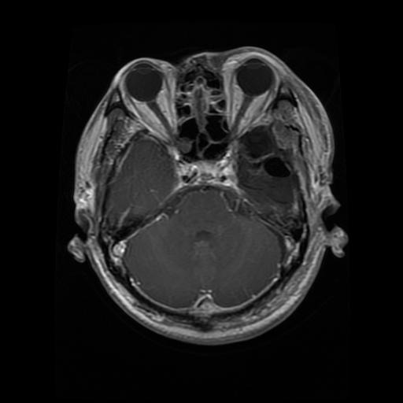
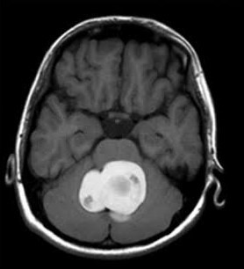
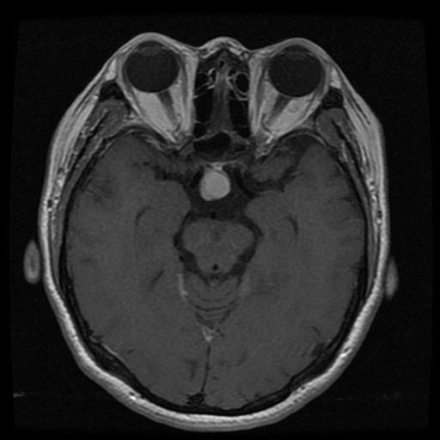
Visuals of Cancers in Dataset
Glioma
Meningioma
Pituitary

Slide 7
Baseline: 0.28
Model | Training Loss | Training Accuracy | Validation Loss | Validation Accuracy
Model A | 0.0932 | 0.9655 | 0.1910 | 0.9564
Model B | 0.2192 | 0.9155 | 0.1784 | 0.9352
Model C | 0.2187 | 0.9172 | 0.2629 | 0.9110

Slide 8
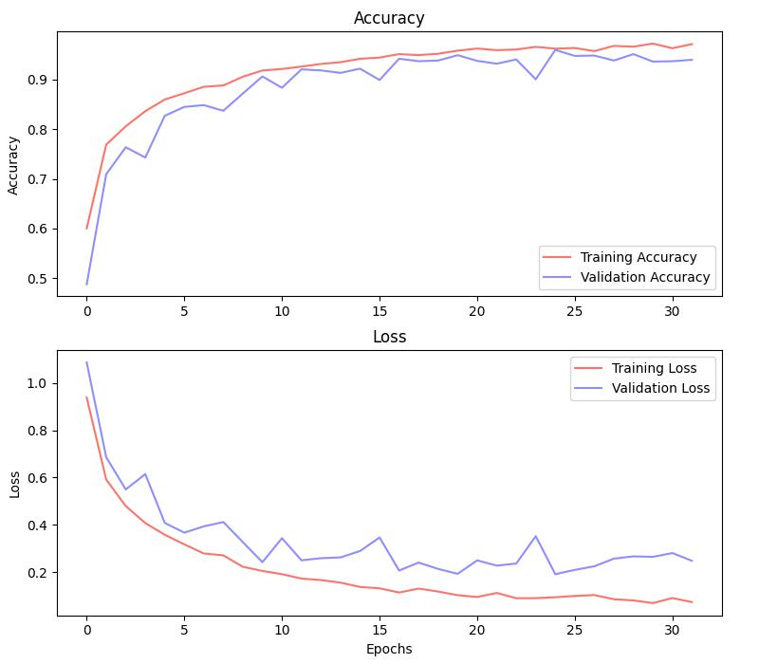
The Training History of Model A

Slide 9
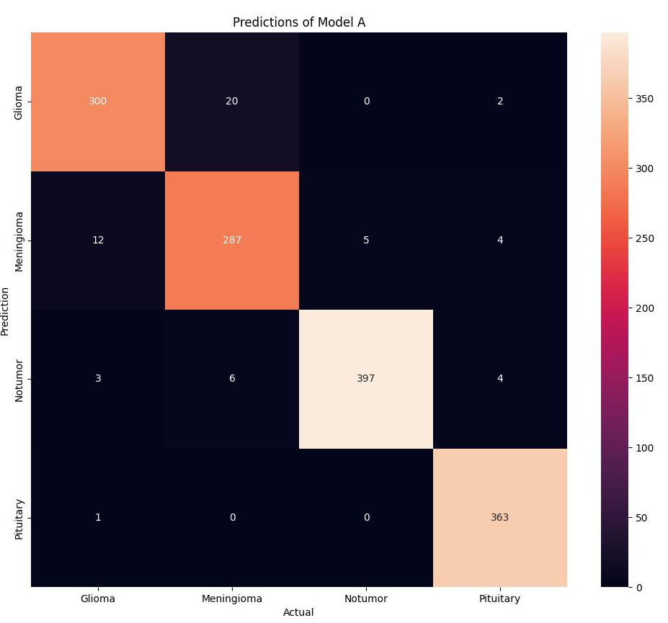
How well does the Model Perform?
Notes:
The Model was given 1,404 images in these categories. It correctly predicted 1,347 correctly. 96% of the images were predicted accurately.

Slide 10
What is Grad-Cam?
Grad-CAM (Gradient-weighted Class Activation Mapping) is a visualization technique that highlights the regions of an input image that are important for a deep neural network's prediction
Notes:
The idea behind Grad-CAM is to compute the gradient of the output class score with respect to the feature maps of the final convolutional layer of a neural network. These gradients are then used to weight the feature maps, producing a coarse localization map that indicates the regions of the input image that were most important for the network's prediction.

Slide 11
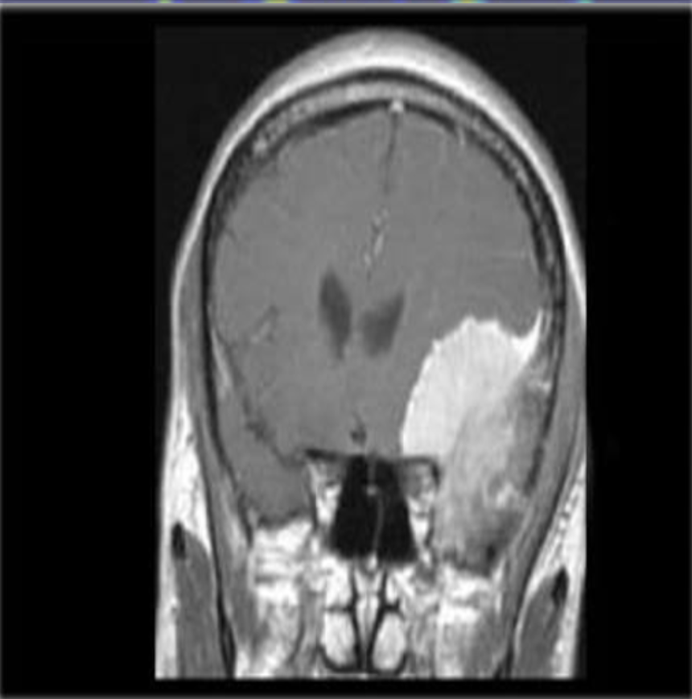
Begin with an image
This MRI Scan is of a person with Meningioma. The tumor is easily visible to the eye, so it’ll be perfect for our demonstration.

Slide 12
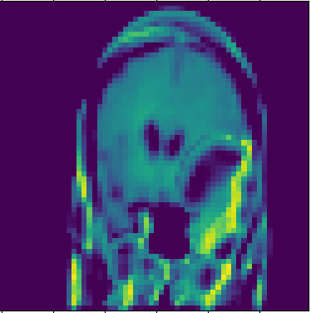
Generating a Heatmap
After an image has been fed through the model, it needs to have the “weights” computed.
Then these weights are used to multiply each feature map and summed up to obtain the final localization map.
Its then resized and has a ReLu activation to get rid of negative values.

Slide 13
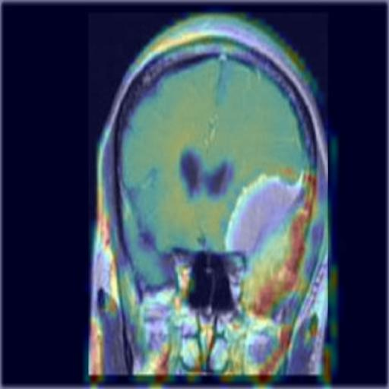
Overlaying the Heatmap
By overlaying the heatmap over the image, we can visually see what portions of the image are “important” to why it predicted Meningioma.
The goal, and the usual occurrence, is that the tumor is a deciding factor.
So the model can not only predict what cancer is present in an MRI scan, but also tell the user where it is located.

Slide 14
A neural network can be used to accurately predict if cancer is in an mri scan, and give its assumption of where it might be located in the image.

Slide 15
How Can This Model Help Your Hospital
A Second Opinion
Save Expenditures
Reassure your doctor’s opinions
Speed up Diagnosis
Reliable and informative
Diagnosis to treatment faster
Less time spent analyzing scans
More time for doctors
Notes:
While this model is undergoing further training, the doctor’s at your hospital could use this as a second opinion. Your doctors will benefit from having a second opinion from a model trained on thousands of images to recognize patterns. And can help reassure them of their opinion to speed up diagnosis.
Doctor’s will be able to speed up diagnoses, which will mean less time spent on each scan. That in turn will mean more patients are able to move through the diagnosis stage and intro treatment stage faster.

Slide 16
Next Steps
COntinue Training
App Development
Increase Accuracy even further

Slide 17
Thank you!
Do you have any questions?
skibokate@gmail.com
github.com/kskibo

